Slide 1
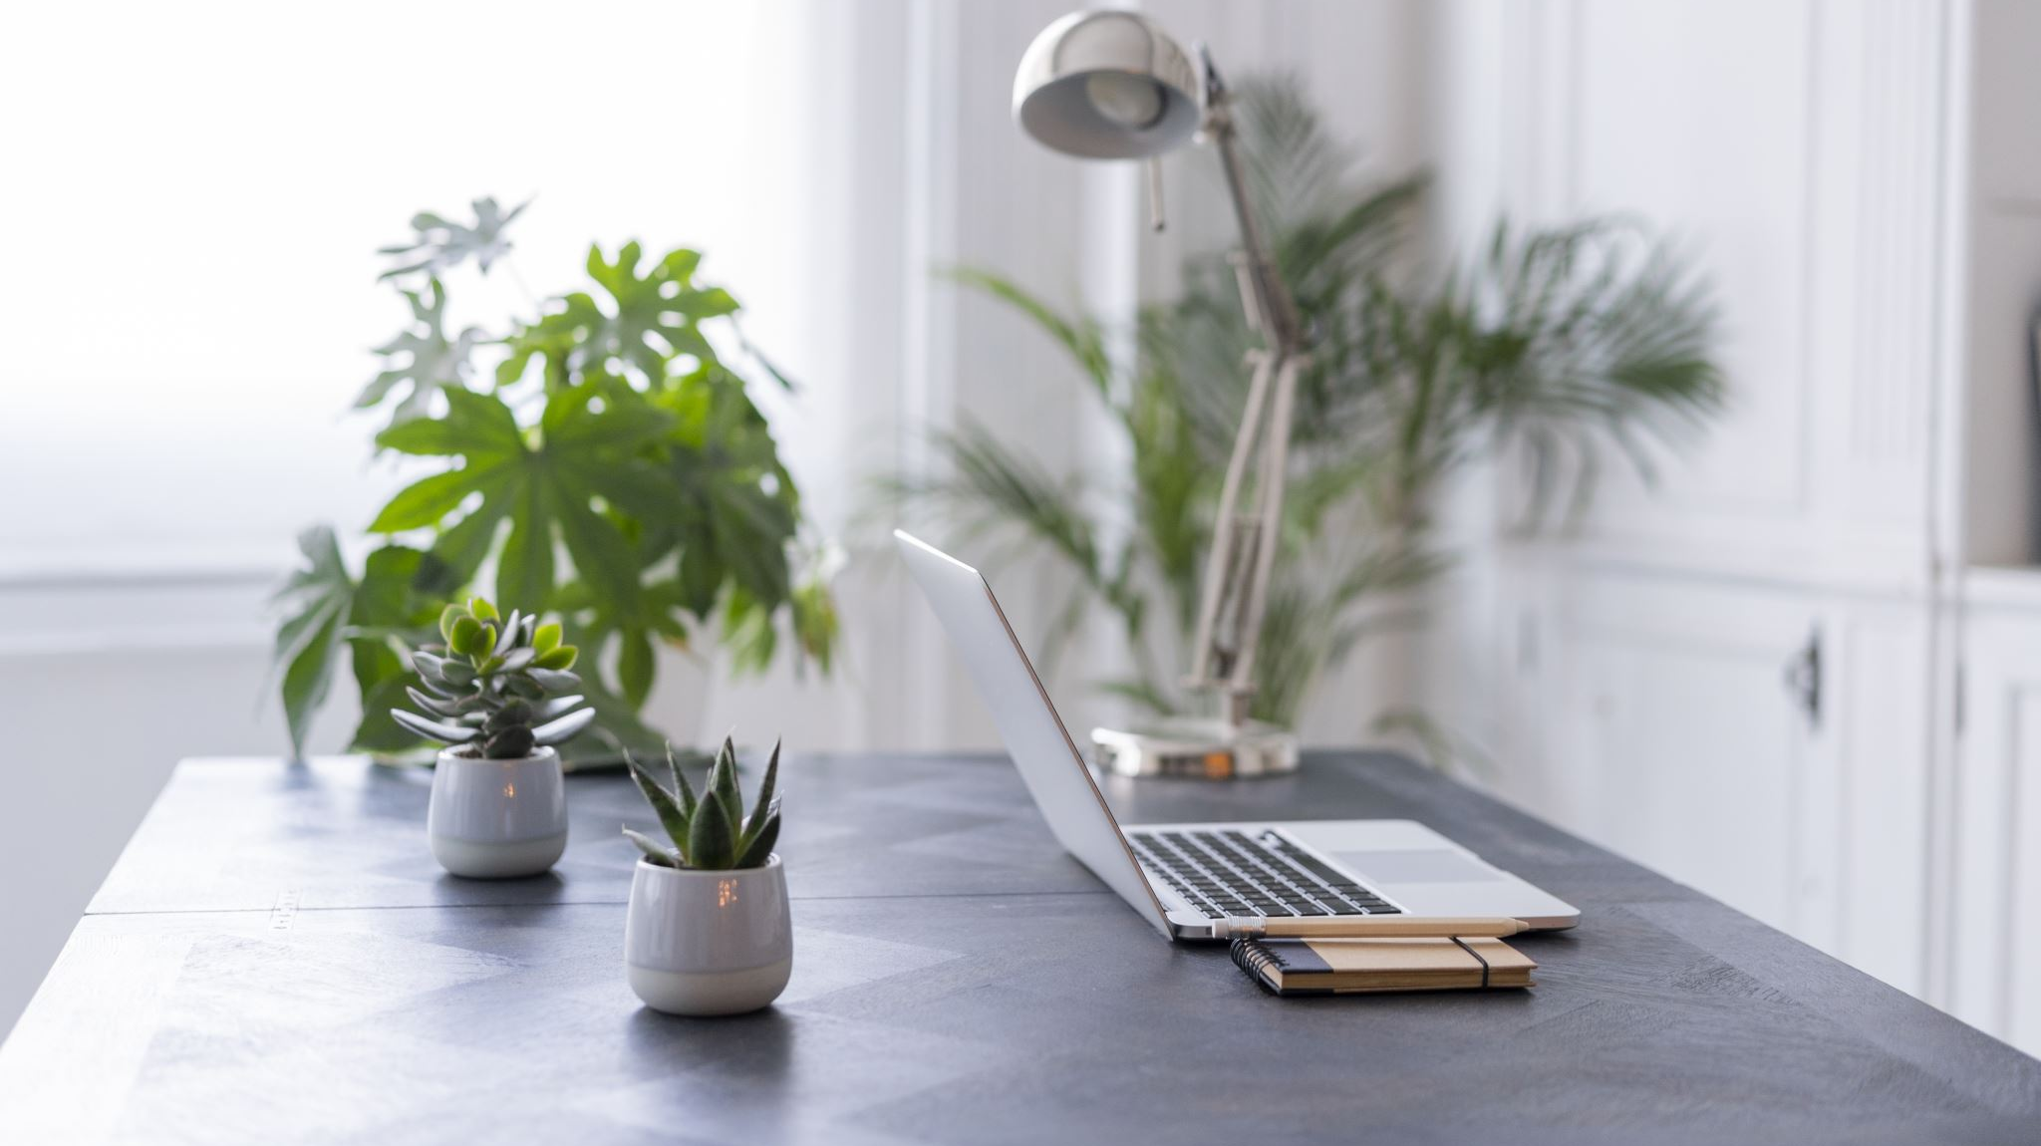
Working From Home
Computer Graphics and Fundamentals
Project presentation
Aleksander Aaboen, Tormod Mork Müller and Martin Iversen

Slide 2
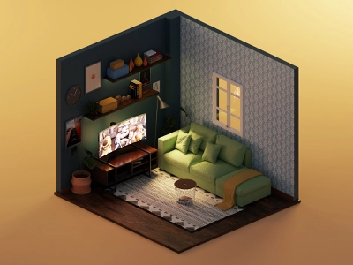
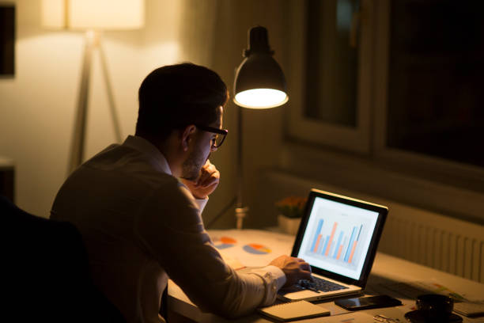
Idea
Four renders
How natural light interact with a work from home environment
Synthetic and natural light
Day
Night
Notes:
Martin

Slide 3
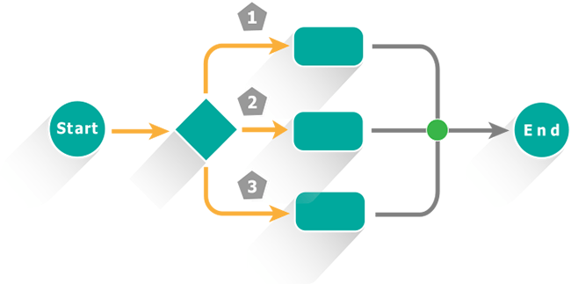
Process
Project proposal
Brainstorming
Room construction
Walls
Window
Object mapping and placement
Blender objects from turboSquid
Lighting conditions
Assignment 2 and pbrt-v3 input file format

Slide 4

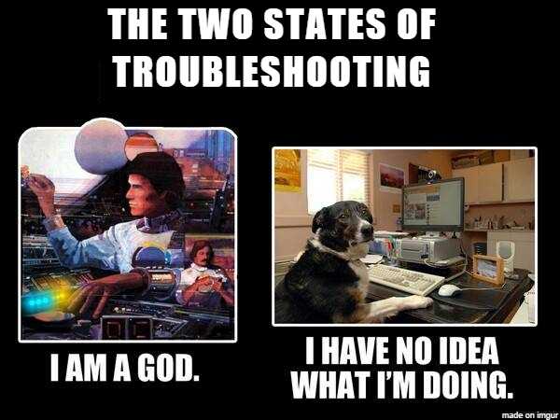
Problems
Scene building (360 image)
Window building (ray tracing)
Integer maxdepth
Texture mapping complex objects
Blend to obj
Assimp (fbx)
Texture mapping
Troubleshooting

Slide 5
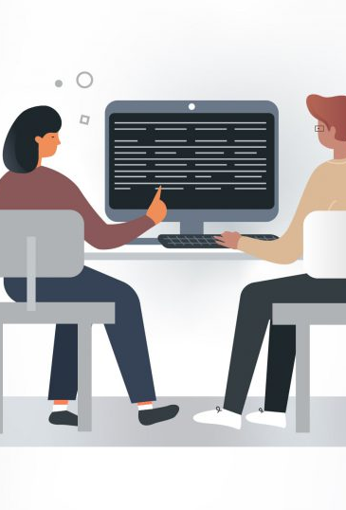
Teamwork
Initially:
3 renders, one each
Not practical at all
Solution:
Pair programming
Main programmer and advisor/helping hand
Everyone gets to see different aspects
Common understanding
Same page
Notes:
Martin

Slide 6
Results
Realistic
Shadow
Reflection
Rays
Unrealistic
Textures

Slide 7
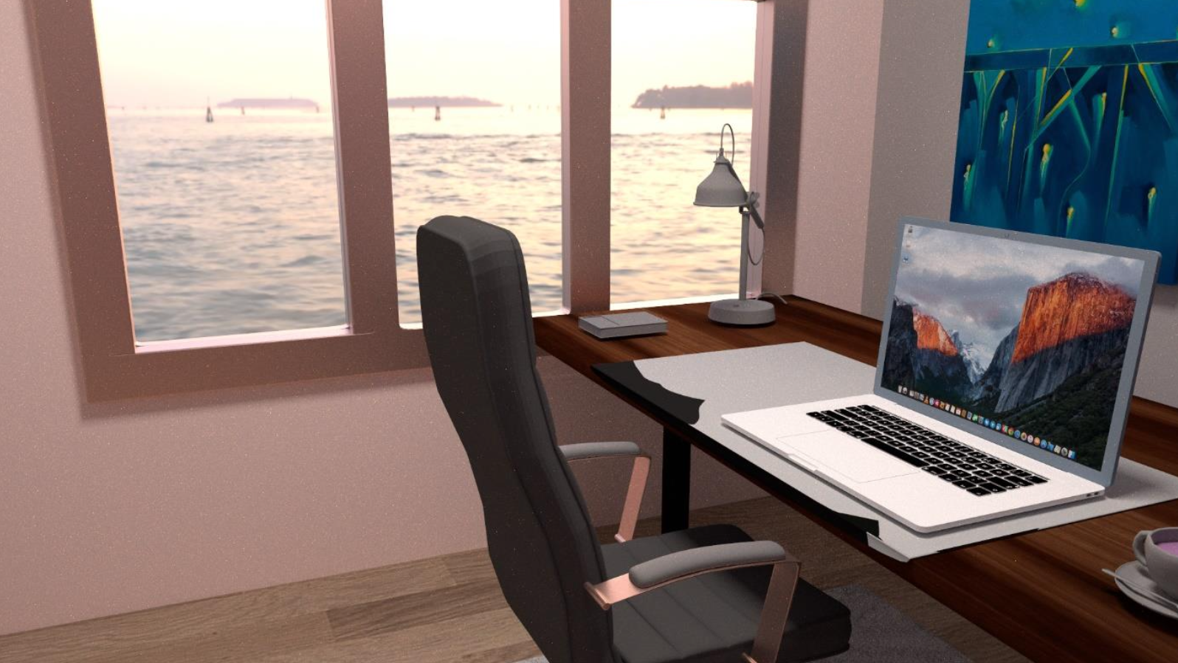

Slide 8
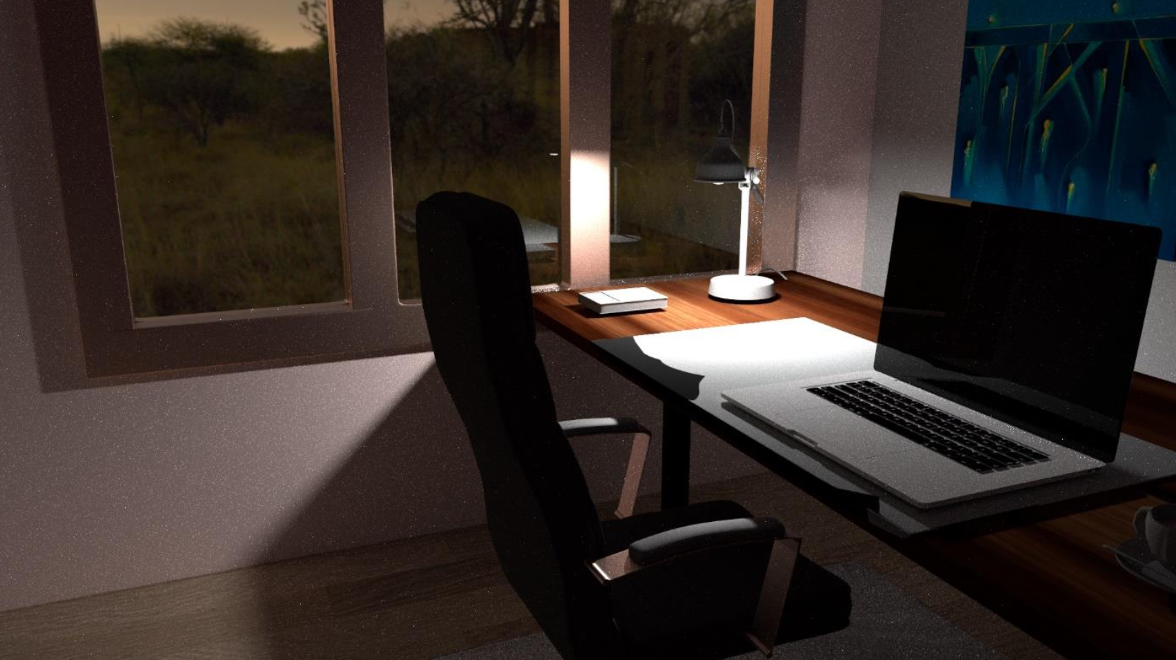

Slide 9
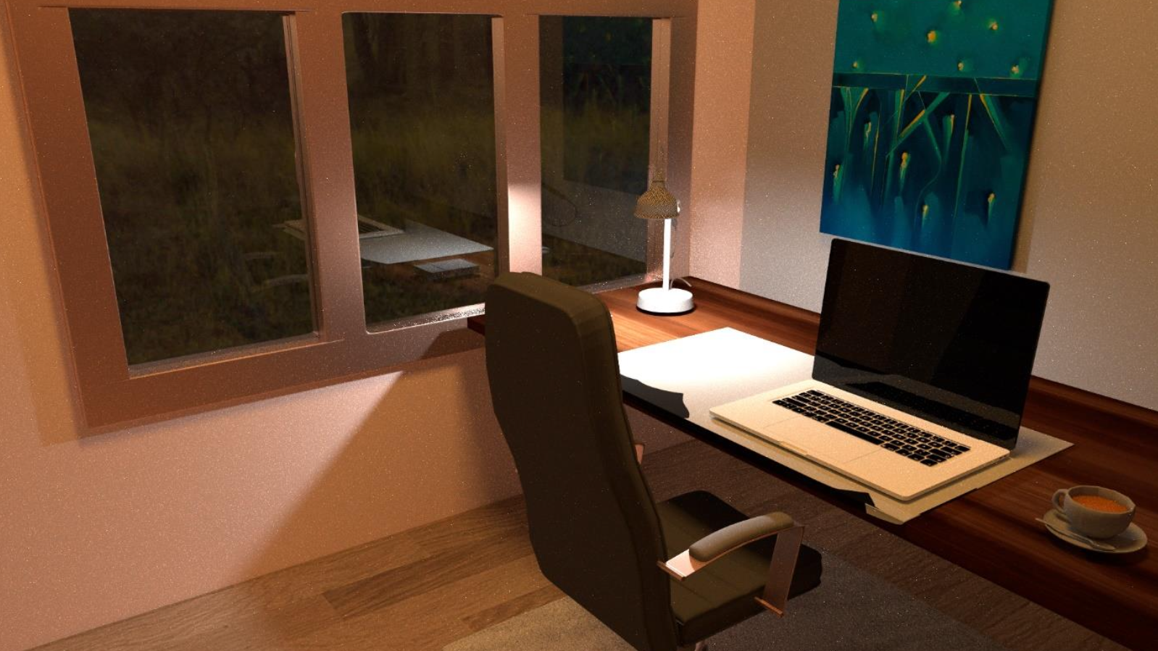

Slide 10
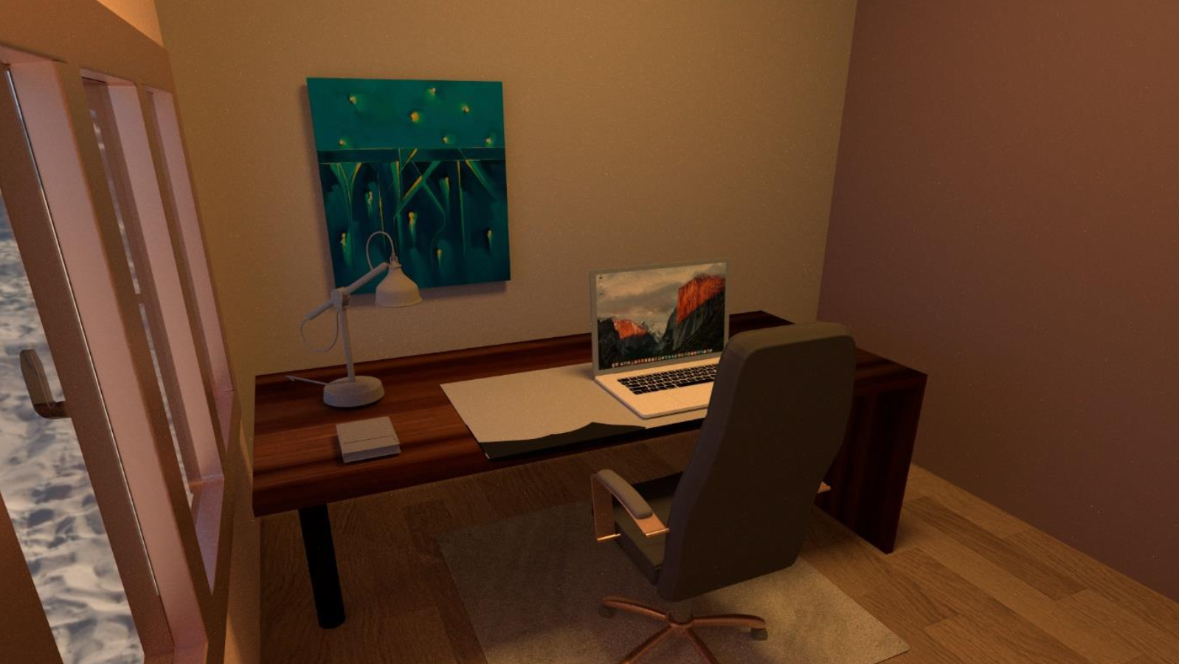

Slide 11
Reflection
PBRT is hard to work with
Very little documentation
Troubleshooting nightmare
Teamwork went well
Pair programming
Everyone contributed
Applying theory?
Lectures vs Pbrt
Happy with the results
Even though not all textures fit perfectly

